Slide 1
PIP4004: UNIVERSITY PROJECT Review-4 Presentation
Language translator tool to convert English to Hindi.
Batch Number: CSD-19
Under the Supervision of,
Dr. Leelambika K V
Assistant Professor
School of Computer Science and Engineering
Presidency University
Roll Number | Student Name
20211CSD0167 20211CSD0104 20211CSD0100 20211CSD0004 | A Rohith Kumar Mahesh Gowda S Divya D Parimi Ushoday
Name of the Program: Bachelor of Technology
Name of the HoD: SairaBanu Atham
Name of the Program Project Coordinator: Dr. Manjula H M
Name of the School Project Coordinators: Dr. Sampath A K / Dr. Abdul Khadar A / Mr. Md Ziaur Rahman

Slide 2
Introduction
The English-to-Hindi Language Translator Tool is designed to facilitate seamless communication by converting text from English to Hindi with high accuracy. Utilizing Neural Machine Translation (NMT) and advanced AI models, the tool ensures context-aware, fluent, and grammatically correct translations. It is built for various applications, including education, business, and multilingual content creation. With features like real-time translation, API integration, and offline support, this tool aims to bridge language barriers and enhance accessibility for Hindi-speaking users.

Slide 3
Literature Review
Machine Translation (MT) involves automatic conversion of text between languages.
Challenges in translating from English to Hindi include syntax, grammar, and idiomatic expressions.
Popular translation tools include Google Translate, Microsoft Translator, and DeepL.AI and Natural Language Processing (NLP) improve translation accuracy by understanding context.
Neural Machine Translation (NMT) offers more fluent and accurate translations than older systems.
Applications include real-time communication, content localization, and government documents.
Future improvements focus on enhancing cultural context, emotional tone, and personalized translation.
Challenges with Existing Tools: Lack of context-aware translations. Poor handling of official government terminology.

Slide 4
Proposed Method
1. Rule-Based Machine Translation (RBMT)
2. Statistical Machine Translation (SMT)
3. Neural Machine Translation (NMT)
4. Data Augmentation and Preprocessing
5. API-Based Translation System

Slide 5
Objectives
Develop an Accurate Translation System
Improve Contextual Understanding
Enhance Linguistic Fluency
Implement an Efficient Machine Learning Model
Support Multiple Input Formats

Slide 6
Methodology
Data Collection and Preprocessing:
Collects all the required data from their source and starts to preprocess the data.
Selection of Translation Approach:
Neural Machine Translation (NMT)
Hybrid Approach
Statistical Machine Translation (SMT) (if needed)
Model Training and Optimization:
Train the selected model using a large bilingual dataset.
Implement attention mechanisms to focus on key words in translation.
Development of User Interface (UI):
Design a web-based or mobile-friendly interface for users to input text.
Provide features like text input, speech-to-text, and copy-to-clipboard functionality.
API Integration and Deployment:
Develop an API to integrate the translation model with chat applications, and mobile apps.
Deploy the model on cloud platforms (AWS, Google Cloud, etc.) for real-time translation services.
Continuous Improvement and Updates:
Collect user feedback to refine translations and correct errors.

Slide 7
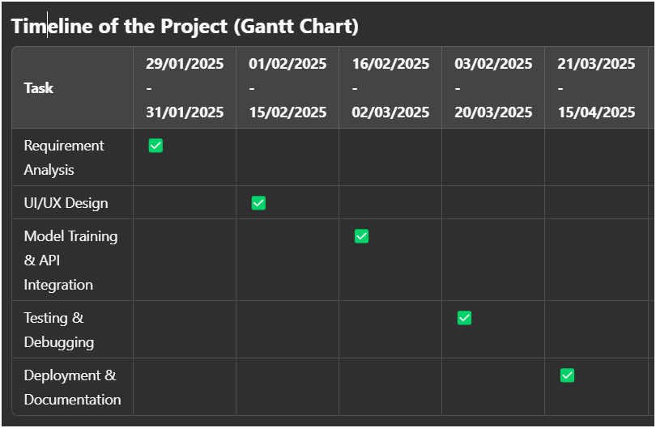
Timeline of the Project (Gantt Chart)

Slide 8
Excepted Outcomes
Accurate and Context-Aware Translations
Fluent and Natural-Sounding Output
Fast and Efficient Translation Process
User-Friendly and Interactive Interface
Scalability and Integration Capabilities
Offline and Low-Resource Support
High Evaluation Scores
Achieving competitive BLEU, METEOR, and ROUGE scores compared to existing translation tools.

Slide 9
Conclusion
The English-to-Hindi Language Translator Tool enhances accuracy, fluency, and contextual relevance in translations using Neural Machine Translation (NMT).
It offers a user-friendly, efficient, and scalable solution for real-time and offline translation across various domains. With API integration, continuous learning, and performance optimization, the tool aims to bridge language barriers and improve multilingual communication.
Future enhancements include voice translation, expanded language support, and domain-specific improvements for even better accuracy and usability.

Slide 10
Github Link
Github Link:
https://github.com/PARIMI-USHODAY/CSD-19

Slide 11
References (IEEE Paper format)
[1] Dorr, B.J., Jordan, P.W. & Benoit, J.W. 1999. A survey of current paradigms in machine translation. Advances in Computers, 49, 2 68.
[2] Harshawardhan, R., Mridula Sara Augustine and K.P. Soman, 2011. Phrase based English – Tamil Translation System by Concept Labeling using Translation Memory. International Journal of Computer Applications (0975 – 8887), Volume 20– No.3.
[3] Hui Yang, Anne de Roeck, Vincenzo Gervasi, Alistair Willis , and Bashar Nuseibeh, 2011. Analysing anaphoric ambiguity in natural language requirements. Springer-Verlag London Limited.
[4] Koehn, P., Och, F.J. &Marcu, D. 2003. Statistical phrase-based translation. InNAACL ’03: Proceedings of the Conference of the North American Chapter of the Association for Computational Linguistics on Human Language Technology, 48–54, Association for Computational Linguistics, Morristown, NJ,USA.
[5] Koehn, P., Hoang, H., Birch, A., Callison-Burch, C., Federico, M.,Bertoldi, N., Cowan, B., Shen, W., Moran, C., Zens, R., Dyer, C.,Bojar, O., Constantin, A. &Herbst, E. Moses 2007. Open sourcetoolkit for statistical machine translation. In ACL, The Association for ComputerLinguistics.
[6] Lehmann, T. 1989.. A Grammar of Modern Tamil .Pondicherry Institute of Linguistics and Culture.
[7] Maritz,J.S. 1981.Distribution-Free Statistical Methods, Chapman &Hall. ISBN 0-412-15940-6, page 217.
[8] Myers, Jerome L., Well, Arnold D, 2003. Research Design and Statistical Analysis. Second Edition, Lawrence Erlbaum,pp. 508, ISBN 0-8058-4037-0.

Slide 12


